Slide 1
PROMIS Network second workshop: “Modelling and Design for Photonics”
Single Photon Detection:
Technologies & Applications
Emna AMRI
R&D Engineer at IDQ and PhD Student at GAP, Geneva University.
Cadiz, May 18, 2016

Slide 2
Progress up to date
Single Photon detection
 |  |  | Technologies
 |  |  | Applications for security

Slide 3
Progress up to date
Single Photon detection
 |  |  |  |  |  | InGaAs/InP single photon detectors
 |  |  | Technologies
 |  |  |  |  |  | CMOS Single Photon Avalanche Diodes
 |  |  | Applications for security

Slide 4
Progress up to date
Single Photon detection
 |  |  |  |  |  | InGaAs/InP single photon detectors
 |  |  | Technologies
 |  |  | Applications for security
 |  |  |  |  |  | CMOS Single Photon Avalanche Diodes
Achievement:
Characterization of Free-running InGaAs/InP single photon avalanche detector with 50ps temporal jitter achieved at very low excess bias voltage.
Scientific output:
A paper abstract was submitted and accepted to
SPIE 2016.
A paper is being drafted and is to be submitted to Optics Letters (OSA).
Achievement:
Dark Count Rate (DCR) and After-Pulsing (AP) characterization of gated CMOS SPADs for Quantum Random Number Generation purpose.

Slide 5
Progress up to date
Single Photon detection
Technologies
Application for security
Quantum Random Number Generation
Exploiting randomness in
photon emission process.

Slide 6
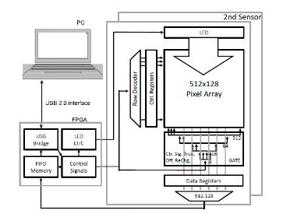
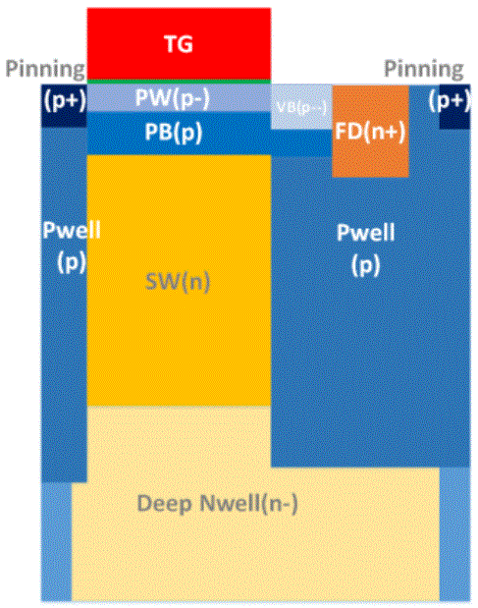
Progress up to date
CMOS SPADs Matrix
Achievement:
An entropy/bit of 0.9 has been obtained for raw data at room T for low bias voltage.
Scientific output:
A Poster was presented in DATE 2016 (Workshop on Trustworthy Manufacturing and Utilization of Secure Devices) March, Dresden-CH.
Single Photon detection
Technologies
Block diagram of the QRNG
Application for security
Quantum Random Number Generation
Quanta Image Sensor (QIS)
Exploiting randomness in
photon emission process.
Achievement:
Generating randomness using a CMOS
image sensor with single photon detection capability and 200��^{𝟐} size pixels (jots).
Scientific output:
Schematic of a “jot” structure
A paper was submitted to Special issue:
Photon counting image sensors and is
still in review.
6

Slide 7
Future steps
Single Photon detection
 |  |  |  |  |  | InGaAs/InP single photon detectors
 |  |  | Technologies
 |  |  | Applications for security
 |  |  |  |  |  | Others
Future steps:
Finish the characterization measurements.
Finalizing the paper writing.
Prepare the talk for SPIE conference: “Optical Sensing, Imaging, and Photon Counting: Nanostructured and metamaterial Devices and Applications”, San Diego, 31 August 2016.
7

Slide 8
Future steps
CMOS SPADs Matrix
Single Photon detection
Future steps:
Co-integration of the SPADs matrix with post-processing digital blocks.
➔ Secondment in TU Delft for design review (end of Juin)
Technologies
Application for security
Quantum Random Number Generation
Quanta Image Sensor (QIS)
Exploiting randomness in
photon emission process.
Future steps:
Co-filing a patent with Pr. Eric Fossum about QIS utilization for QRNG.
Investigate the possibility of using QIS for further applications such as optical instrumentation.
8

Slide 9
Conclusion
Progress:
The project has been well progressing thanks to the collaboration of the engineers in IDQ and the scientists in the GAP.
Secondments:
Group of Applied Physics: Quantum Technologies: A PhD work during 3 years.
TU Delft: scheduled for end of Juin.
Looking forward to constructive exchanges with other ESRs that may lead to fruitful collaborations.

